Slide 1
Leading in Complexity – Public Health’s Challenge
Professor Kevin Fenton CBE PrFPH PhD
President, Faculty of Public Health

Slide 2
Leading in Complexity – Public Health’s Challenge
2024: Complex times for health
Health challenges
Economic challenges
Structural and political challenges
The public health landscape
Our leadership values in this context
A relentless focus on equity
Working with cross-system partners
A vision for the public’s health

Slide 3
2024: Complex times for health
Health challenges
Life expectancy is stalling across the UK for the first time in a century, and even falling in some areas.
More people are living with chronic, major health conditions.
By 2040, almost 1 in 5 of the adult population in England are projected to be living with major illness.
Tackling widening health inequalities including the social and structural drivers which exacerbate risks of morbidity and mortality.
Those in the least deprived areas of the UK can expect to live 70 years in good health, compared to 50 years for the most deprived.
The ongoing threat of communicable diseases including MMR as childhood vaccination rates fall.
Notes:
Major health conditions - https://www.health.org.uk/publications/long-reads/nine-major-challenges-facing-health-and-care-in-england#:~:text=Smoking%2C%20poor%20diet%2C%20physical%20inactivity,and%20mortality%20in%20the%20UK.&text=All%20of%20these%20risk%20factors,structural%20social%20and%20economic%20conditions.
Life expectancy disparities - https://www.health.org.uk/evidence-hub/health-inequalities/life-expectancy-and-healthy-life-expectancy-at-birth-by-deprivation

Slide 4
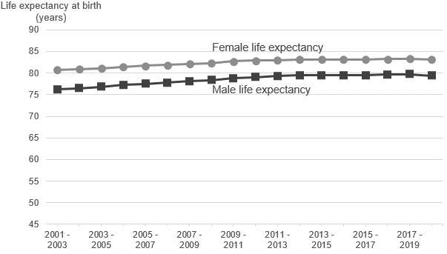
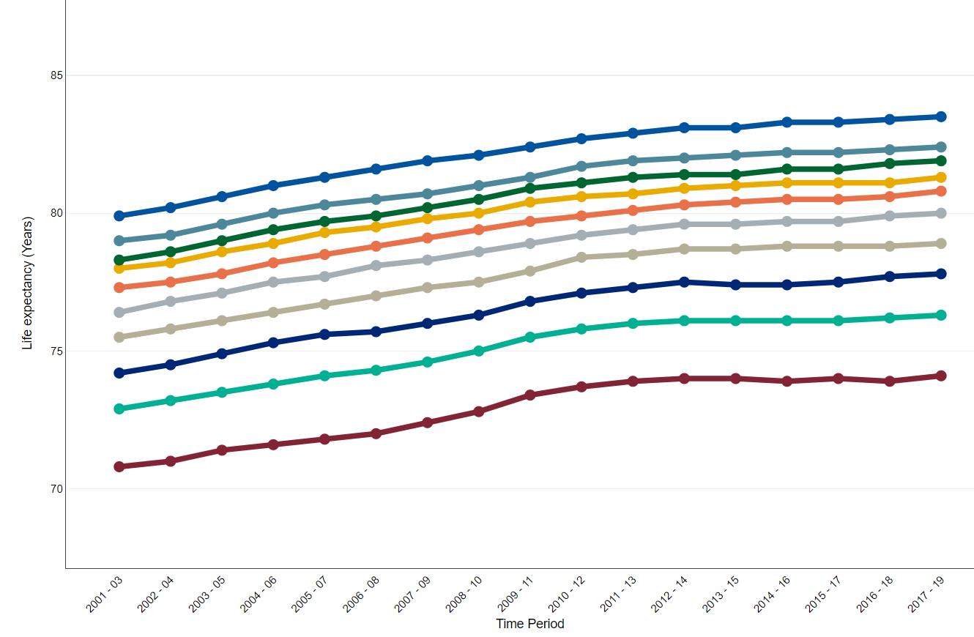
Improvements in life expectancy have stalled and the gap in life expectancy is widening
Life expectancy (LE) at birth for males and females in England 2001-03 to 2018-20
Life expectancy for males – by deprivation deciles, 2001-2019
Source: ONS, 2022
Source: British Heart Foundation. 2022. UK Factsheet. BHF UK CVD Factsheet.
Upward trend in LE in England seen in the 20th Century has stalled and is now declining in older adults living in poorer areas.
Following the pandemic, LE fell by 1.3 years for males and 1.0 year for females in 2020.
The rise in life expectancy is slowing and the deprivation gap is widening

Slide 5
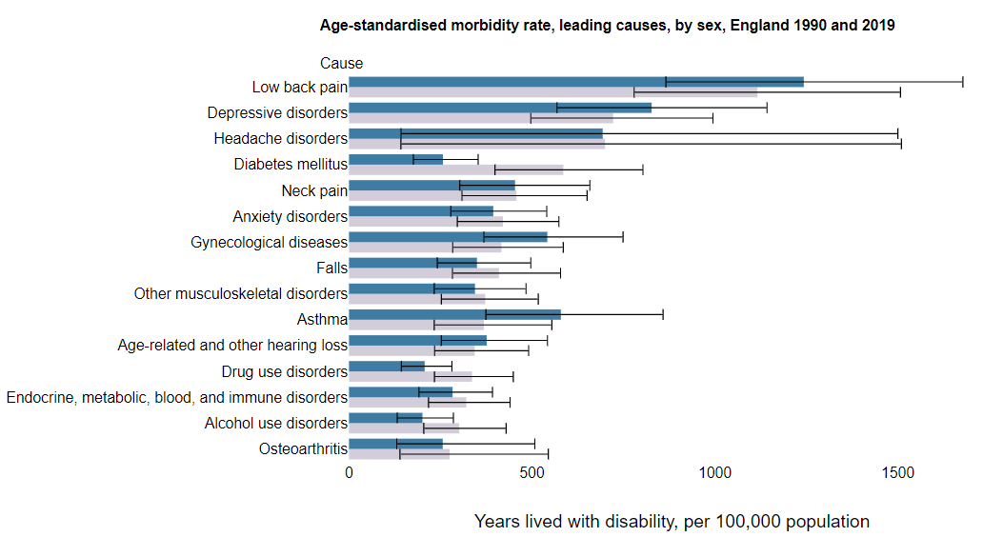
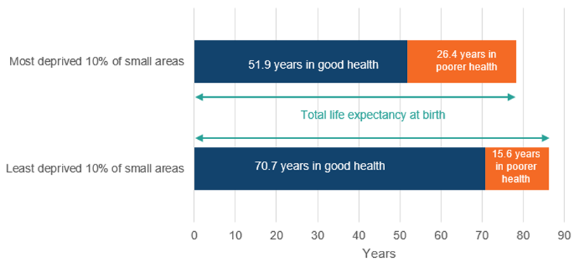
Disparities in healthy life expectancy are even more acute
Healthy life expectancy (HLE - the average years of life lived in good health) is not improving in England.
Stark disparities in the number of years people can expect to live in good health between deprivation groups.
There are good public policy reasons to refocus our longer-term efforts on tackling morbidity and not just mortality.
Expectations of life spent in good and poorer states of health for females in the most and least deprived areas in England
Source: Global Burden of Disease 2019

Slide 6
2024: Complex times for health
Economic challenges
Cost-of-living crisis impacting vulnerable communities across the UK with families struggling to heat homes, access healthy food, and facing declining mental and physical health.
Declining economic productivity leading to increasing unemployment, wage stagnation, and underinvestment in health and social services.
Rising rates of child poverty, with 4.2 million children (29% of all UK children) in poverty, up from 3.6 million in 2010-11.
62% of Bangladeshi, 59% of Pakistani and 53% of Black children live below the poverty line.
Notes:
Child poverty stats - https://cpag.org.uk/child-poverty/poverty-facts-and-figures

Slide 7
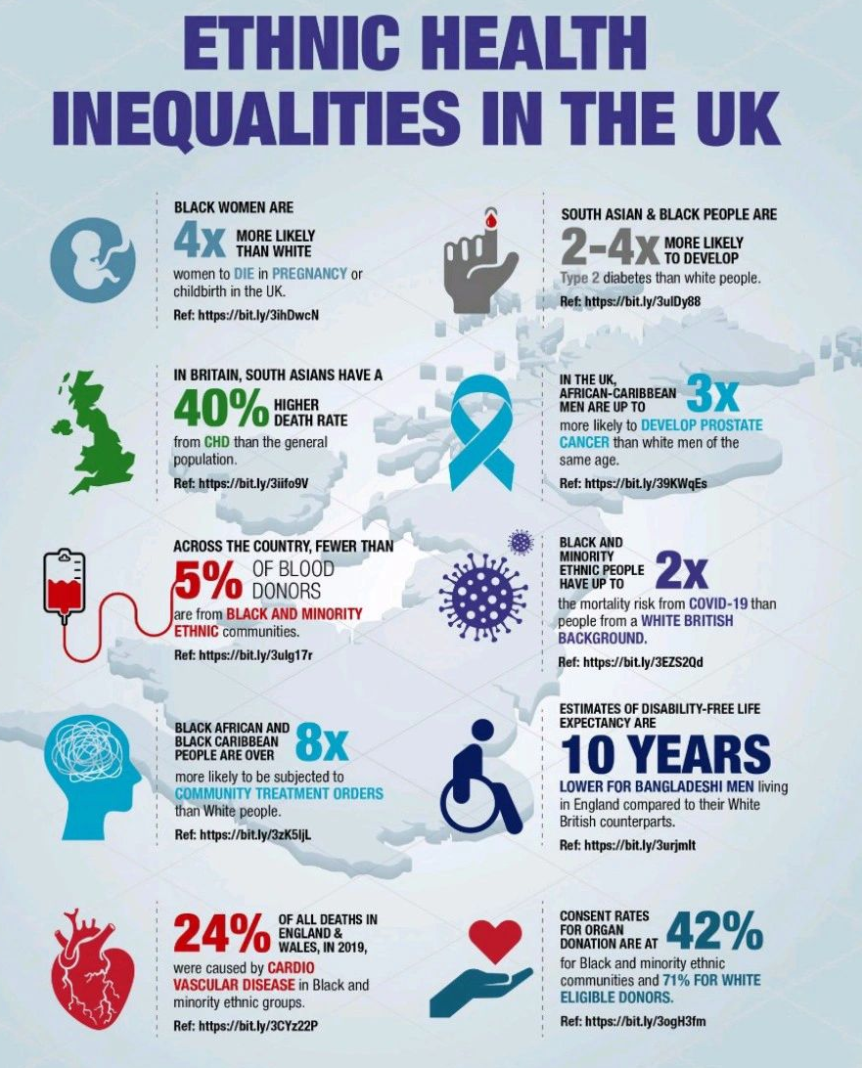
2024: Complex times for health
Structural and political challenges
Structural racism continues to impact the health of minority ethnic communities across the UK.
Black women in the UK are 4x more likely to die during pregnancy or childbirth.
South Asian people have a 40% higher death rate from coronary heart disease.
Global conflict and the direct and indirect impact on the health of communities across the UK.
A global ‘year of elections’ with shifting priorities at home and abroad.

Slide 8
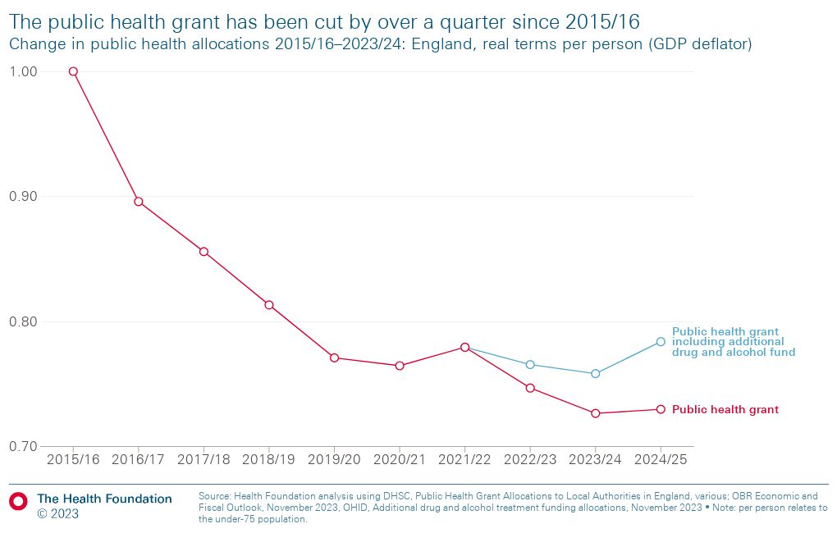
2024: Our landscape in public health
As we face these increasing, complex challenges we do so with diminishing resources.
The public health workforce has faced budget cuts, staff shortages, and frequent reorganisation as we grapple with these mounting challenges.
The number of public health specialists has declined from 22.2 per million population in 2004 to 18.6 per million population in 2020.
In England, the public health grant has faced a real-terms per person cut of 26% since 2015/6, hitting the most deprived areas hardest.
We are facing difficult conversations about prioritisation and the reality of ‘doing less with less’ as budgets shrink.
Notes:
PH spending - https://www.kingsfund.org.uk/insight-and-analysis/data-and-charts/spending-public-health#:~:text=In%202023%2F24%2C%20the%20value,spending%20cut%20is%20even%20greater.

Slide 9
Our leadership values in this context
A new paradigm for public health leadership – an agile approach to working which transcends traditional models and embraces the intricate realities of our time.
Requires us to abandon simplistic narratives and embrace the inherent complexity of our systems.
We must collaborate across sectors, including within ICS structures. Practitioners, clinicians, researchers, and community leaders all hold fragments of the solution.
Critical thinking, and a systems-level perspective, with a relentless focus on principles of equity and justice.
We must understand the interconnected web of factors shaping our challenges and address the root causes, leading visibly with courage and compassion.
We must foster trust amongst communities, tackle inequalities, and learn from the Legacies of the COVID-19 pandemic

Slide 10
COVID-19: Learning and legacy for Health Equity
The pandemic shone an unrelenting light on society’s longstanding and pervasive health and social inequalities
Work with our health, care and community partners to clarify the emerging lessons from the pandemic and ensure their application to recovery programmes and other health challenges.
Well resourced, multi-level, equity-focused public health, pandemic preparedness and emergency response infrastructure and systems.
Stronger, innovative and agile partnership working across health and care systems, including voluntary sector, community and social care.
A commitment to high quality, robust programme and health outcomes data and metrics, to better identify, understand and tackle health inequalities
Robust, pragmatic, holistic, programme relevant and participatory research better able to understand and meet the emerging needs of local communities.
Strengthened community-centred and asset-based community approaches, outreach and engagement to improve health and tackling disparities

Slide 11
A relentless focus on equity
Robust leadership, governance and accountability to tackle health inequalities at all levels.
Integrating anti-racism and addressing structural discrimination in our systems and programmes.
Policies and programs that reduce poverty and inequality, such as implementing the living wage, strengthening social care, and providing affordable housing.
We need to ensure that everyone has equitable access to high-quality healthcare - addressing barriers such as language, trust and confidence, and financial.
Promote healthy lifestyles such as eating a healthy diet, exercising regularly, and not smoking. Promoting secondary prevention campaigns through culturally competent and targeted education and public health campaigns.
Provide support to vulnerable groups, such as people living in poverty, migrants and asylum seekers, people with disabilities, and people with mental health problems through a range of services and programs, such as social care and mental health services.

Slide 12
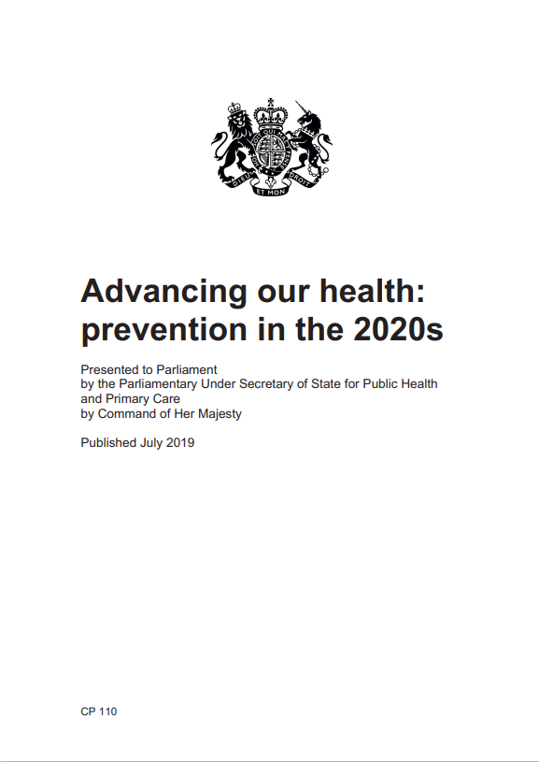
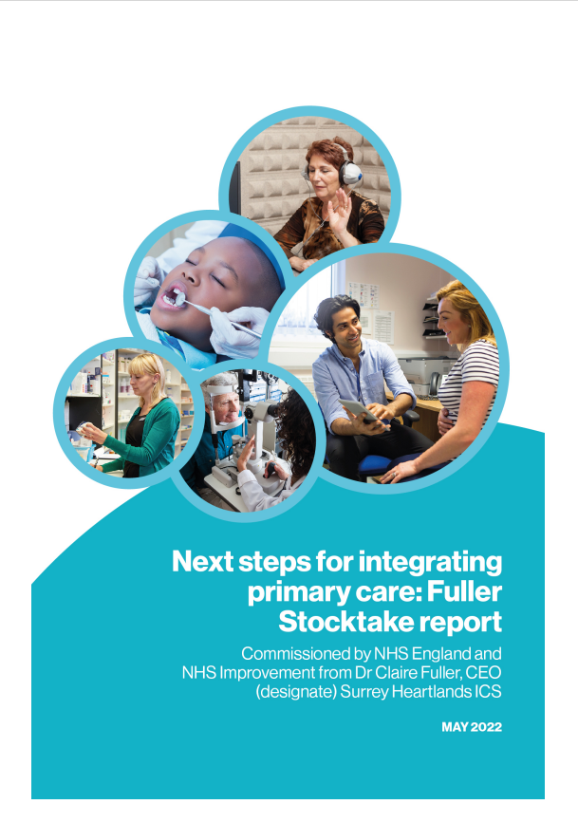
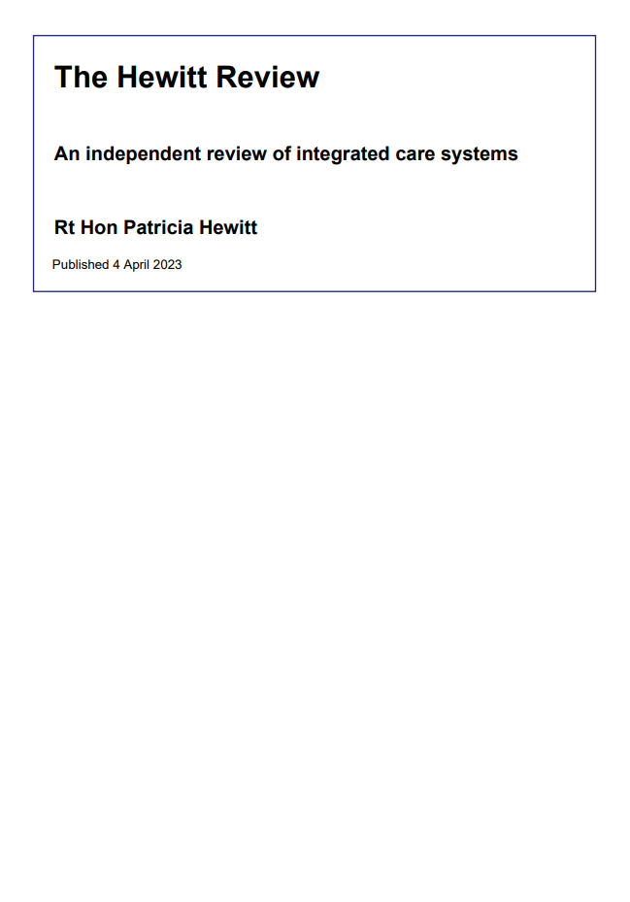
Working cross-system with NHS partners
Wanless: “It will require additional resources to be directed to public health, targeted at those interventions where the long-term impact will be greatest in terms of health gain”
FYFV: “a radical upgrade in prevention”
Hewitt; “While there will always be immediate pressures on our health care system, shifting the focus upstream is essential for improving population health and reducing pressure on our health and care system”
LTP: “More NHS action on prevention and health inequalities…
improving upstream prevention of avoidable illness and its exacerbations”
Prevention Green Paper: “The 2020s will be the decade of proactive, predictive, and personalised prevention.”
Fuller: “Helping people to stay well for longer as part of a more ambitious and joined-up approach to prevention.

Slide 13
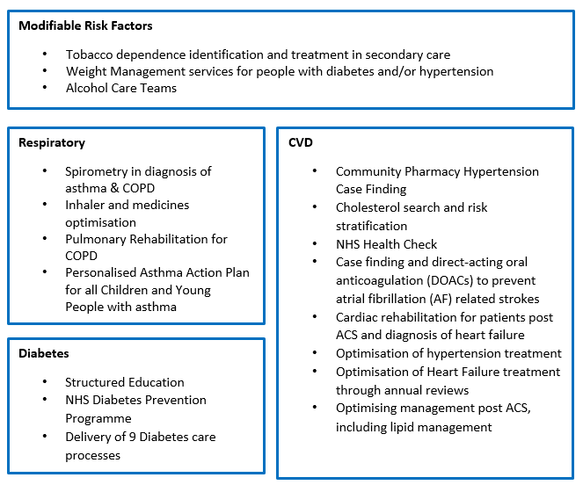
Focus on what we know works
Focus on increasing uptake of evidence based high impact interventions for the prevention and treatment of CVD, diabetes and respiratory disease
NHS England, OHID and NICE have collaborated to produce a resource.
This set out strongly evidence based preventative interventions which are likely to deliver an ROI in -3 years and have the greatest impact on reducing:
Health inequalities
Excess mortality
Admission rates
https://www.england.nhs.uk/ourwork/prevention/secondary-prevention/

Slide 14
A Vision for the Public’s Health
1. Empower and support people and communities to take control of their health and wellbeing
2. Tackle poverty to ensure everyone has the chance to live a long and healthy life
3. Protect the nation from infectious diseases and prepare for health threats and emergencies
4. Increase investment in public health and prevention

Slide 15
Empower and support people and communities to take control of their health and wellbeing (1)
Create a smokefree generation
Implement commitments set out in ‘Stopping the start: our new plan to create a smokefree generation’.
Reduce alcohol-related harm
MUP for England and Northern Ireland.
Long-term and sustainable expansion of alcohol treatment services.
Comprehensive strategy on reducing alcohol harm.
Reduce drug dependence
A non-partisan, independent commission to review UK drug legislation.
Remove barriers to innovative interventions to reduce drug dependence.
People who use drugs should be offered treatment, not punishment.

Slide 16
Empower and support people and communities to take control of their health and wellbeing (2)
Supporting a healthy, sustainable diet
Strategic plan to shift the UK to a healthier, more sustainable diet.
Additional resources and stronger role for local government in governance and delivery of food at local level.
Building a healthy workforce
Better support for people with long-term sickness.
Financial and tax incentives for businesses to invest in staff wellbeing, including through occupational health services.
Tackling inequalities and their drivers
Measurable, long-term targets to reduce health inequalities.
Urgent action to improve the social determinants of health and address underlying health inequalities.

Slide 17
Tackle poverty to ensure everyone has the chance to live a long and healthy life
Addressing poverty and the cost-of-living crisis
Extend the National Living Wage.
Scrap the two-child limit and the benefit cap for universal credit.
Funding for housing associations and local authorities to provide social rent homes.
Giving children the best start in life
Measurable targets for improving support for families during first 1,000 days.
‘Health in all policies’ approach to tackling child poverty.
Expand access to free school meals and other child nutrition programmes.
Addressing the root causes of economic inactivity
UK governments should give local authorities powers to bring together local and national resources and stakeholders to deliver focused action on economic inactivity and ill health.

Slide 18
Protect the nation from infectious diseases and prepare for health threats and emergencies
Taking action on climate-related harm
Implement immediate measures to help limit global warming to 1.5°C, such as accelerating the transition from fossil fuels to renewable energies.
Accelerate the shift to low-carbon transport systems.
Transition to sustainable, affordable plant-based diets.
Consider the impact of climate change in all national and local government policy decisions.
Advise and encourage planning by all organisations to become net zero.
Investing in the specialist public health workforce
Improve awareness of the structures, roles, responsibilities and capabilities of the public health system and workforce.
Regularly review and update national pandemic preparedness plans.
Put local public health directors at the heart of preparations, ensuring local public health voice is heard and recognised.

Slide 19
Increase investment in public health and prevention
Investing in the specialist public health workforce
Expand the specialist public health workforce to 30 per million population.
Properly invest in the training and deployment of these specialists.
National strategy to develop and support the wider public health workforce.
Enhancing public health through fair funding of local services
£1billion increase in local public health funding to reverse real-terms cuts.
All UK governments to commit to a multi-year settlement for public health, providing certainty for transformative investments locally, regionally, and nationally.
Delivering population-level interventions and policies
Embed prevention in routing healthcare practice and clinical pathways.
Cross-system collaboration to improve the wider determinants of health
Invest in research and evaluation.

Slide 20
Faculty of Public Health
Board Focus Areas
Support the wellbeing of the public health workforce who are facing increasingly complex challenges
Work with partners to ensure improved clarity, equity, and experience for public health practitioners across their career pathway
Our People
A resilient, diverse and inclusive UK and global public health workforce fit for the future
Our Partnerships
Effective system leadership to improve the health of the public across all UK nations
We will expand formal and informal relationships with allied public health professionals and organisations focussed on improving the public’s health and tackling health inequalities
Our Policies
A clear, unequivocal, and effective champion for health and equity in all policies
Tackling poverty and the cost-of-living crisis
Maximising NHS prevention & population health
Climate change and health
Tackling health inequalities and a public health approach to anti-racism
Living healthier for longer across the life-course
Our Programmes
Promote evidence-informed public health programmes to improve the public’s health
What is Public Health? Ensuring the FPH is the lead voice for defining our profession, the PH system engaging members
Future Public Health: Building upon the COVID-19 pandemic to steer the future of public health practice, training, and workforce.
Our Global Impact
Promoting and enabling members to contribute to improvements in global health
Continue to deliver on our role as global leaders in training, development and support for the public health workforce and deliver critical policy agendas in partnership with other key global stakeholders

Slide 21
Get involved with the work of the Faculty
There are so many different ways to get involved with the work of the Faculty – each a valuable contribution to your own professional development and to the PH Specialty
Board members
Faculty SIGs
Committee members
CPD Advisers
Advisory Appointment Committees
Examiners

