Slide 1
Healthy Place Shaping Systems Evaluation and Health Needs Assessment in Oxfordshire
PHAST Associates Meeting March 2024
Sue Atkinson
Graham Bickler
Nick Cavill
Cecilia Pyper
Paul Plant
Rosie Rowe

Slide 2
Healthy Place Shaping
Healthy Place Shaping Oxfordshire aims to create sustainable, well designed and thriving communities, which provide a sense of belonging, and where all residents are supported to live healthier and happier lives. The approach was developed in Oxfordshire growing out from the work of the Barton and Bicester Healthy New Town programmes.
From that work grew the three Healthy Place Shaping workstreams:
Built Environment: shaping our local environment so that homes are healthier, people can easily access green spaces and are able to walk, cycle and socially interact
Community activation: we want to work with and through local people, businesses, community groups and schools to empower communities to create their own lasting change. We will support healthy choices, being physically active and feeling safe and connected.
New models of care: re-shaping and developing health, wellbeing and care services. Supporting local people to know how best to look after their health and wellbeing.

Slide 3
Aims of the System Evaluation
To consider how the learning from Cherwell District Council can be utilised by the wider Oxfordshire County to scale up the healthy place shaping approach.
To understand if healthy place shaping is effectively addressing priority health needs and health challenges in Oxfordshire through action on the determinants of these.
To provide evidence about the whole population approach involved in healthy place shaping, including who it is reaching and if it is having a variable impact in different communities such as those with higher levels of deprivation.
To build understanding about what is driving change, including system levers and contextual factors.
To provide evidence to decision makers of the impact local authorities can have on health and wellbeing.
To add to the national evidence-base as to the value of place-based approaches to population health and our understanding of the implementation and value of systems approaches to improving health.
To inform a decision as to whether to invest on-going public funds into healthy place shaping.

Slide 4
Aims of the Health Needs Assessment
to provide evidence and recommendations for Oxfordshire leaders about:
Where best to prioritise efforts
Which activities and initiatives to prioritise
What wider issues need addressing
Any gaps

Slide 5
Two projects
HPS SYSTEM EVALUATION - 2020 – 2023
HPS HEALTH NEEDS ASSESSMENT - 2023
What works and how?
Key drivers?
Continue to invest?
What priorities?
Should it continue and be scaled up across Oxfordshire?
Gaps?
COVID / remote working / action research / inequalities cross cutting
FOR TODAY the focus is on METHODOLOGIES

Slide 6
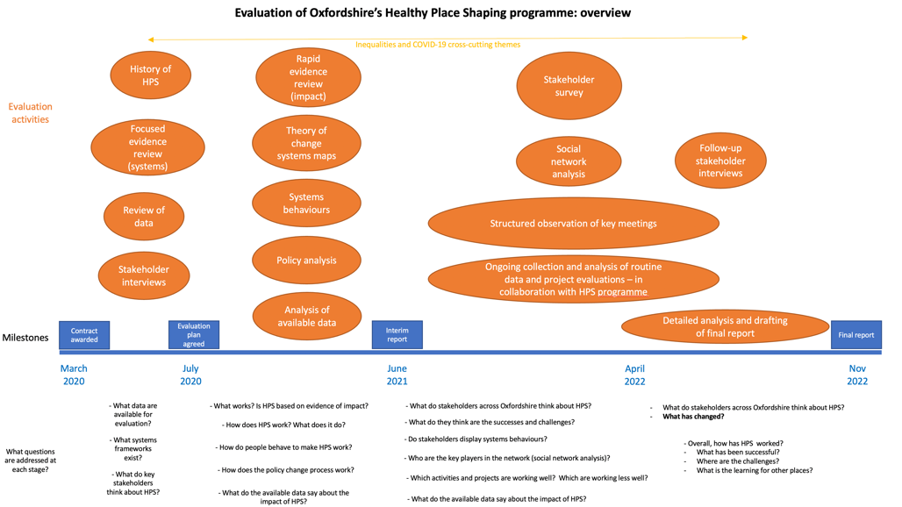

Slide 7
Developing the theory of change
Introduction to diagram style and interpretation
IF we….
AND…
THEN we will achieve…
AND…
RESULTING in…

Slide 8
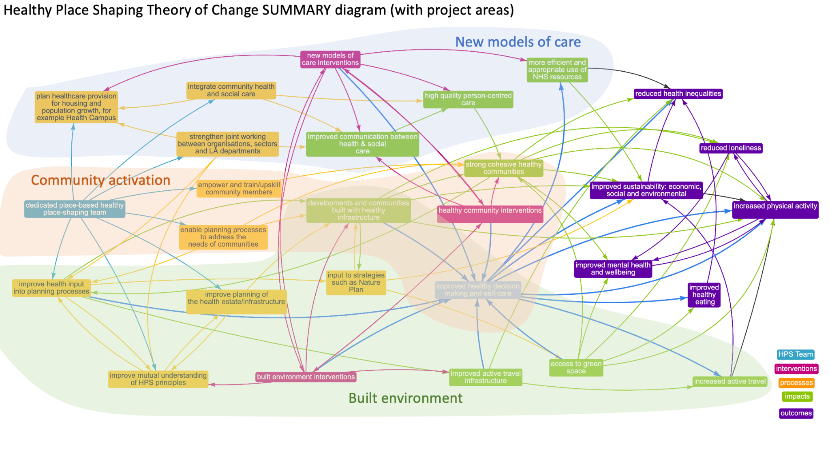

Slide 9
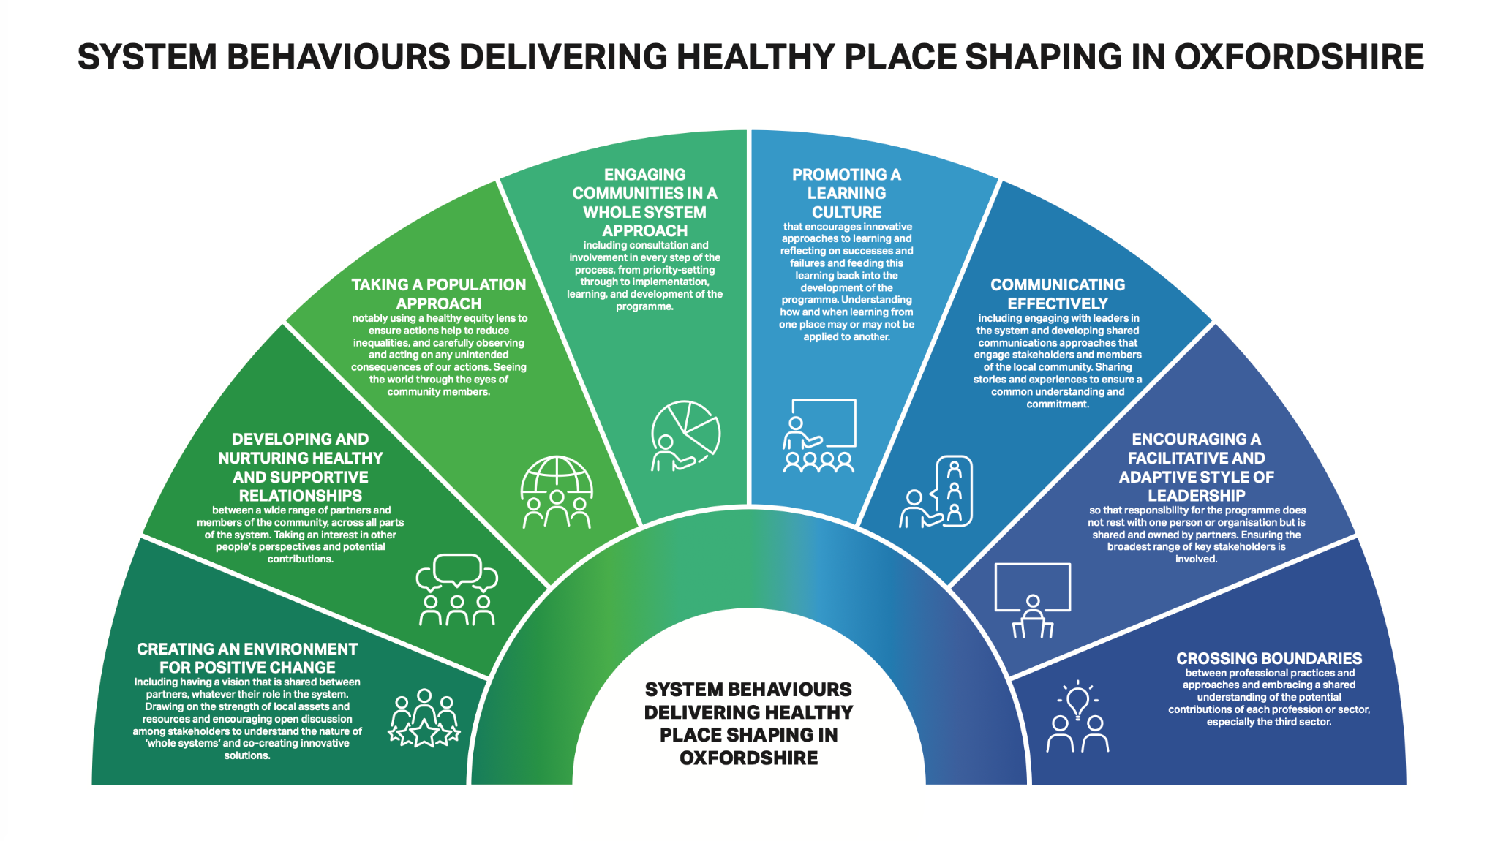

Slide 10
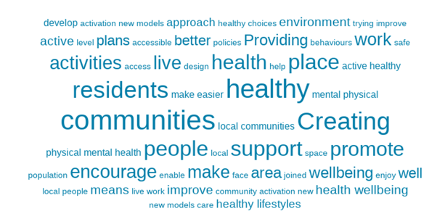
What does ‘Healthy Place Shaping’ mean to you?
The vast majority of responses were strong interpretations of the HPS mission e.g.
“A strategic plan to make it easier to live a healthy life and reduce barriers to inactivity and lack of access/ opportunity to make healthy lifestyle choices.”
“Assisting the creation of sustainable healthy activities in local communities”.
A tiny minority were negative
(Word clouds are used for qualitative responses: these show the most frequently mentioned words in the largest font)

Slide 11
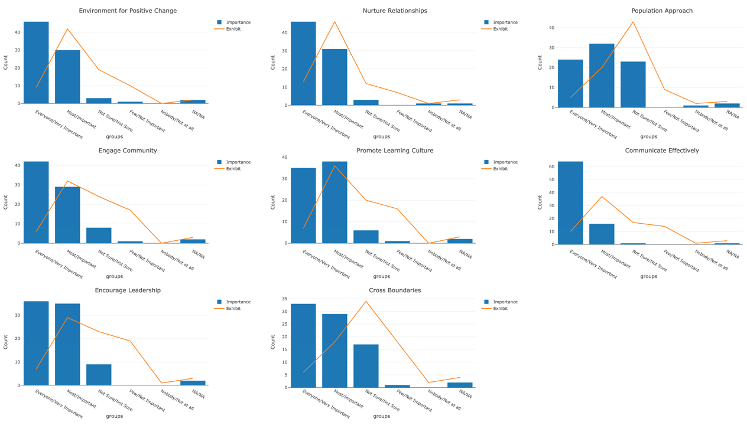
Crossing boundaries; population approach; and communicating effectively are the anomalies here

Slide 12
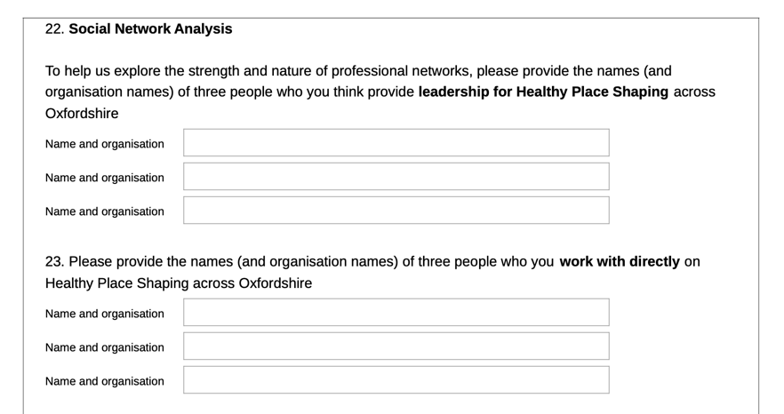
Social Network Analysis questions

Slide 13
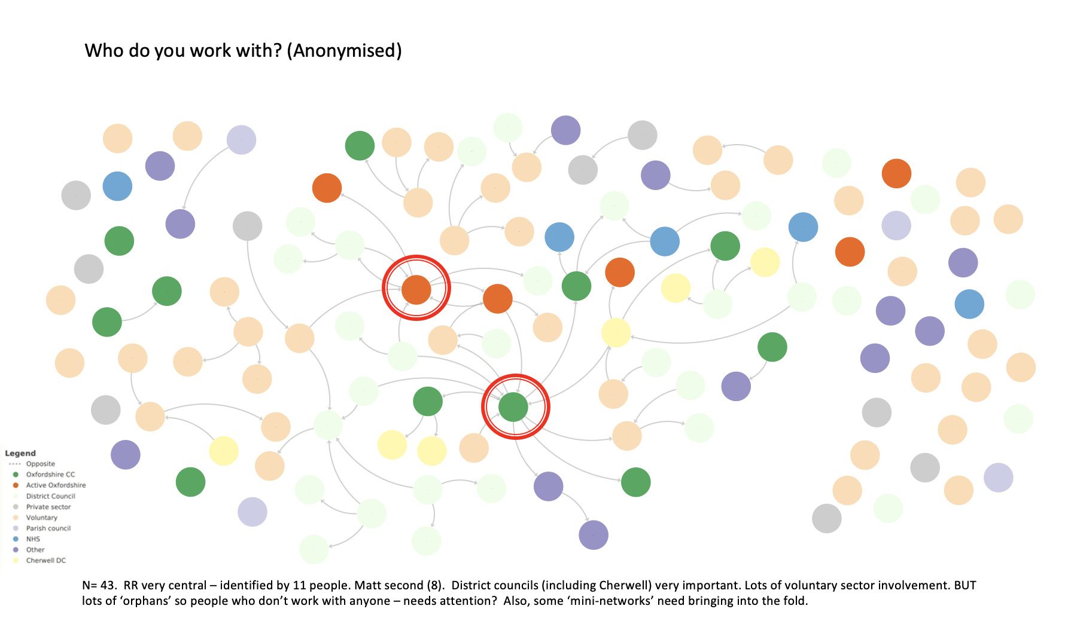

Slide 14
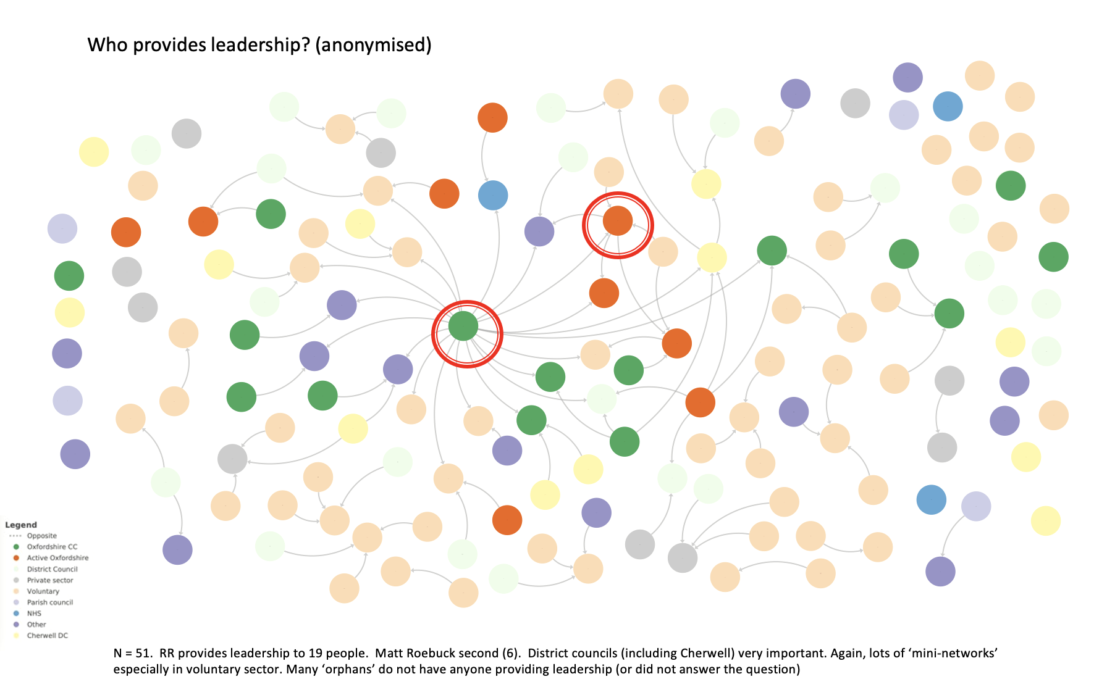

Slide 15
Data
Stage 1
identified wealth of data, reports and evaluations in connection with the Bicester HNT programme and Cherwell HPS work
these related predominantly to outputs and process rather than outcomes and/or uptake by more deprived populations
and hadn’t been used systematically to understand impacts
Stage 2
aimed to make best use of available data
and identify how to use and manage data in future
Stage 3
supported HPS to take data issues forward

Slide 16
Stage 3 final report……
limited data on the impacts of HPS on the whole population or on specific communities, but HPS has started to use data more systematically to understand the impacts of specific initiatives and on the whole population including communities with higher deprivation levels
minimum data set proposed, agreed and implemented for all HPS funded or affiliated projects - some evaluation reports for individual projects have used it
HPS data group established to develop basket of HPS population indicators. Proposed indicators supported by the Oxfordshire HIB and are now part of established annual cycle of updating Oxfordshire JSNA. HPS supported this process and developed the principles and criteria for the indicators
Recommended to continue to improve how data are used to support evaluation and drive change and progress….including on inequalities
Recommended to build on the system evaluation of HPS with increased use of the agreed Minimum Data Set (MDS) and basket of indicators.

Slide 17
Observations
Extant data provided few insights into impact of HPS
PHAST input largely to improve processes related to data collection and use [minimum data set, population indicators] such that
HPS embeds systematic data gathering as routine throughout the programme to provide for ongoing and future quantitative evaluation
systematic use of data becomes an important part of governance and accountability and acts as a driver of change.

Slide 18
Population indicators
Across five broad areas
Built environment
Community activation
New models of care
Process indicators
Wellbeing

Slide 19
Policy analysis
Reviewed whether HPS is embedded in policies/strategies
Whole-system working is more likely to become embedded where whole systems principles are integrated into strategy and policy documents and actions and policies are present at both strategic and operational levels.¹⁹ (NICE)
Findings -`July 2021
HPS well embedded at Oxfordshire level (eg Growth Board and HWB) but not in CCG
Less well embedded at District LAs, not yet in strategic plans
Not yet embedded into ‘operational’ policies eg planning
Recognise timescales for strategy and policy development
Later better embedded in high level strategies and policies
Conclusion:
Systems behaviours and embedding the programme into mainstream processes and across all relevant organisations at all levels are key to HPS sustainability

Slide 20
Meeting observation
The evaluation team attended 20 selected key meetings in 2021–22 as observers.
This took an ‘embedded researcher’ approach, to develop a deeper understanding of HPS actions; ways of working; and influence on key policies.
A meeting observation framework was developed that was used in each observed meeting. This assessed:
System behaviours
Actions and proposed actions – assessed in relation to the ‘Action Scales Model’ (Nobles et al 2021).
Other data was also collected in relation to specific topics; such as inequalities, use of evidence, influence, opportunities identified, initiatives shared and transferred and any negative behaviours
-- `used the ‘Action Scales Model’ (Nobles et al 2021) - a simple model that helps policymakers and evaluators conceptualise, identify and appraise actions within complex adaptive systems. Identifies “upstream” and “downstream” actions.
The meetings observed ranged from Oxfordshire County Council to various local authority meetings, specific HPS meetings and local stakeholder or demonstrator project meetings, covering specific topics within HPS such as cycling and housing.

Slide 21
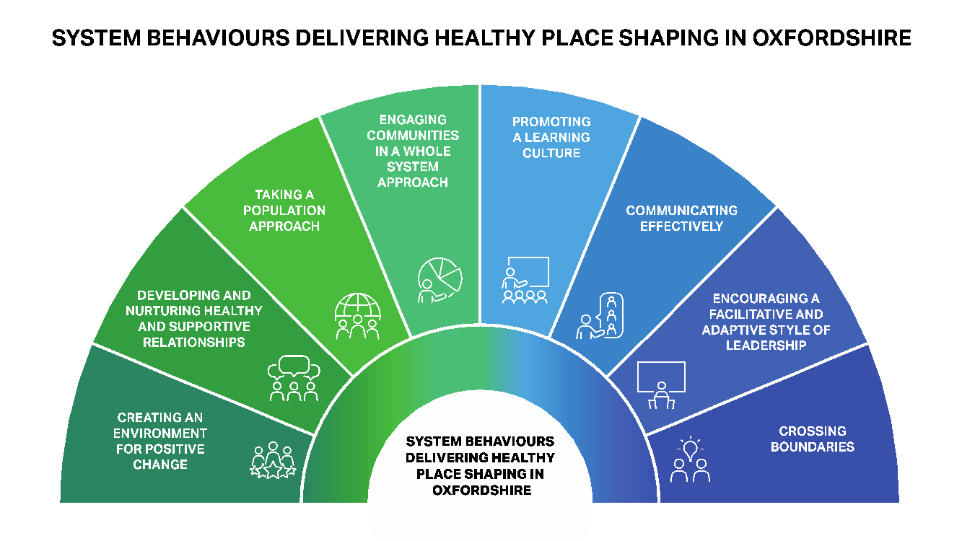

Slide 22
Very brief results
HPS systems behaviours are being demonstrated in many of the HPS related meetings.
However, these behaviours are less well demonstrated in more formal strategic, Oxford- wide meetings.
HPS appears to be being adopted strategically by Oxfordshire’s formal structures but would benefit from increased involvement of District Authorities to roll out across Oxfordshire.
Much of the activity observed can be classed as more operational i.e. ‘events’ in the Action Scales Model.
Ideally it would be good to have HPS itself recognised as a ‘belief’ or ‘goal’ by all such organisations to embed HPS across the system.
Adoption of HPS within Health systems remains a challenge.

Slide 23
Reflection on the method(s)
Pragmatic approach during lockdown
Enabled an insight into processes
Gave us a good overview
Use of structured form allowed analysis of behaviours and actions
Clearly not as insightful as a real embedded approach
Were we attending the right meetings?
Does the real work take place outside meetings?

Slide 24
Health Needs Assessment - aims and methods
Aims - to provide evidence and recommendations about:
Where best to prioritise efforts
Which activities and initiatives to prioritise
What wider issues need addressing
Any gaps
Methods - drew on the well established Stevens and Raftery HNA framework:
Epidemiological [local epidemiology and effectiveness of local services]
Comparative [how similar programmes work elsewhere]
Corporate [views of key leaders and stakeholders about HPS to date and next steps]
…..using epidemiological analysis, literature reviews, interviews with local leaders and stakeholders and interviews with external informants

Slide 25
Epidemiological: focus on where to prioritise
Oxfordshire JSNA and data from systems evaluation provided sufficient analysis of what and where major health issues were
Interviews with stakeholders confirmed account of where most deprived / needy areas were
Concluded that should stick with 10 most deprived wards, but also use MSOA data outside those 10 wards
Notes:
Recommendations on HPS overall:
HPS should continue to be supported to develop its potential to improve health and decrease inequalities in Oxfordshire, both as a programme and as an approach
HPS should focus on the 10 most deprived areas across Oxfordshire to tackle inequalities
HPS should retain the focus on its 3 workstreams
Built environment
Community activation
New models of care
HPS should specifically recognise cross cutting activities including high level strategic partnerships
HPS should ensure that the broader health and well-being principles that underpin HPS are considered at a strategic level and within all organisations’ strategies and policies as well as applying across the 3 workstreams.
HPS should extend its collaborations / partnerships with wider partners and particularly with the NHS, using the opportunities that arise from primary care and PCNs as well as from both the ICS and Anchor Institutions.

Slide 26
Comparative: focus on learning from literature and other places
Other Healthy New Towns
PHAST found nothing new in terms of objectives or partners with whom these areas are working that isn’t happening in other parts of the country and in Oxfordshire. There were no initiatives identified that can be simply transported into Oxfordshire’s programme.
Examples of place shaping from elsewhere in the country
There are many reports and examples of healthy place shaping from across UK. Initiatives have local names but are similar to those areas of activity Oxfordshire has prioritised.
Considerable need for training about how to undertake HIAs adequately.
HIAs are increasingly building in climate change / sustainability interventions, so adding to their complexity.
The academic and grey literature on healthy place shaping
Very few local initiatives have been rigorously evaluated.
From those that have been evaluated, the literature shows that successful healthy place shaping requires strong, local, place-based partnerships involving a range of organisations and the communities themselves
Use whole systems and Health in all Policies approaches

Slide 27
Corporate: interviews of key Oxfordshire stakeholders
Stakeholders included:
County and District council officers, including senior staff from Public Health
Oxfordshire County Council councillors
Local NHS leaders including from the Integrated Care System
GPs and Primary Care Network leaders
Before the interviews they received a brief summary of the HPS Systems Evaluation including HPS’s Key Priority Areas
The interviews were recorded, transcribed then summarised and the recommendations were identified.
A total of 11 meetings took place
Notes:
PHAST explored the following themes with them:
Their current role and involvement with HPS
Their knowledge about HPS
How they would like to see HPS develop in the future
What they saw as the key priorities for HPS if resources were limited.

Slide 28
Interviews particularly covered
how HPS is addressing inequalities
and confirmed that HPS should continue to prioritise the ‘top 10’ deprivation electoral wards identified by the Oxfordshire public health team.

Slide 29
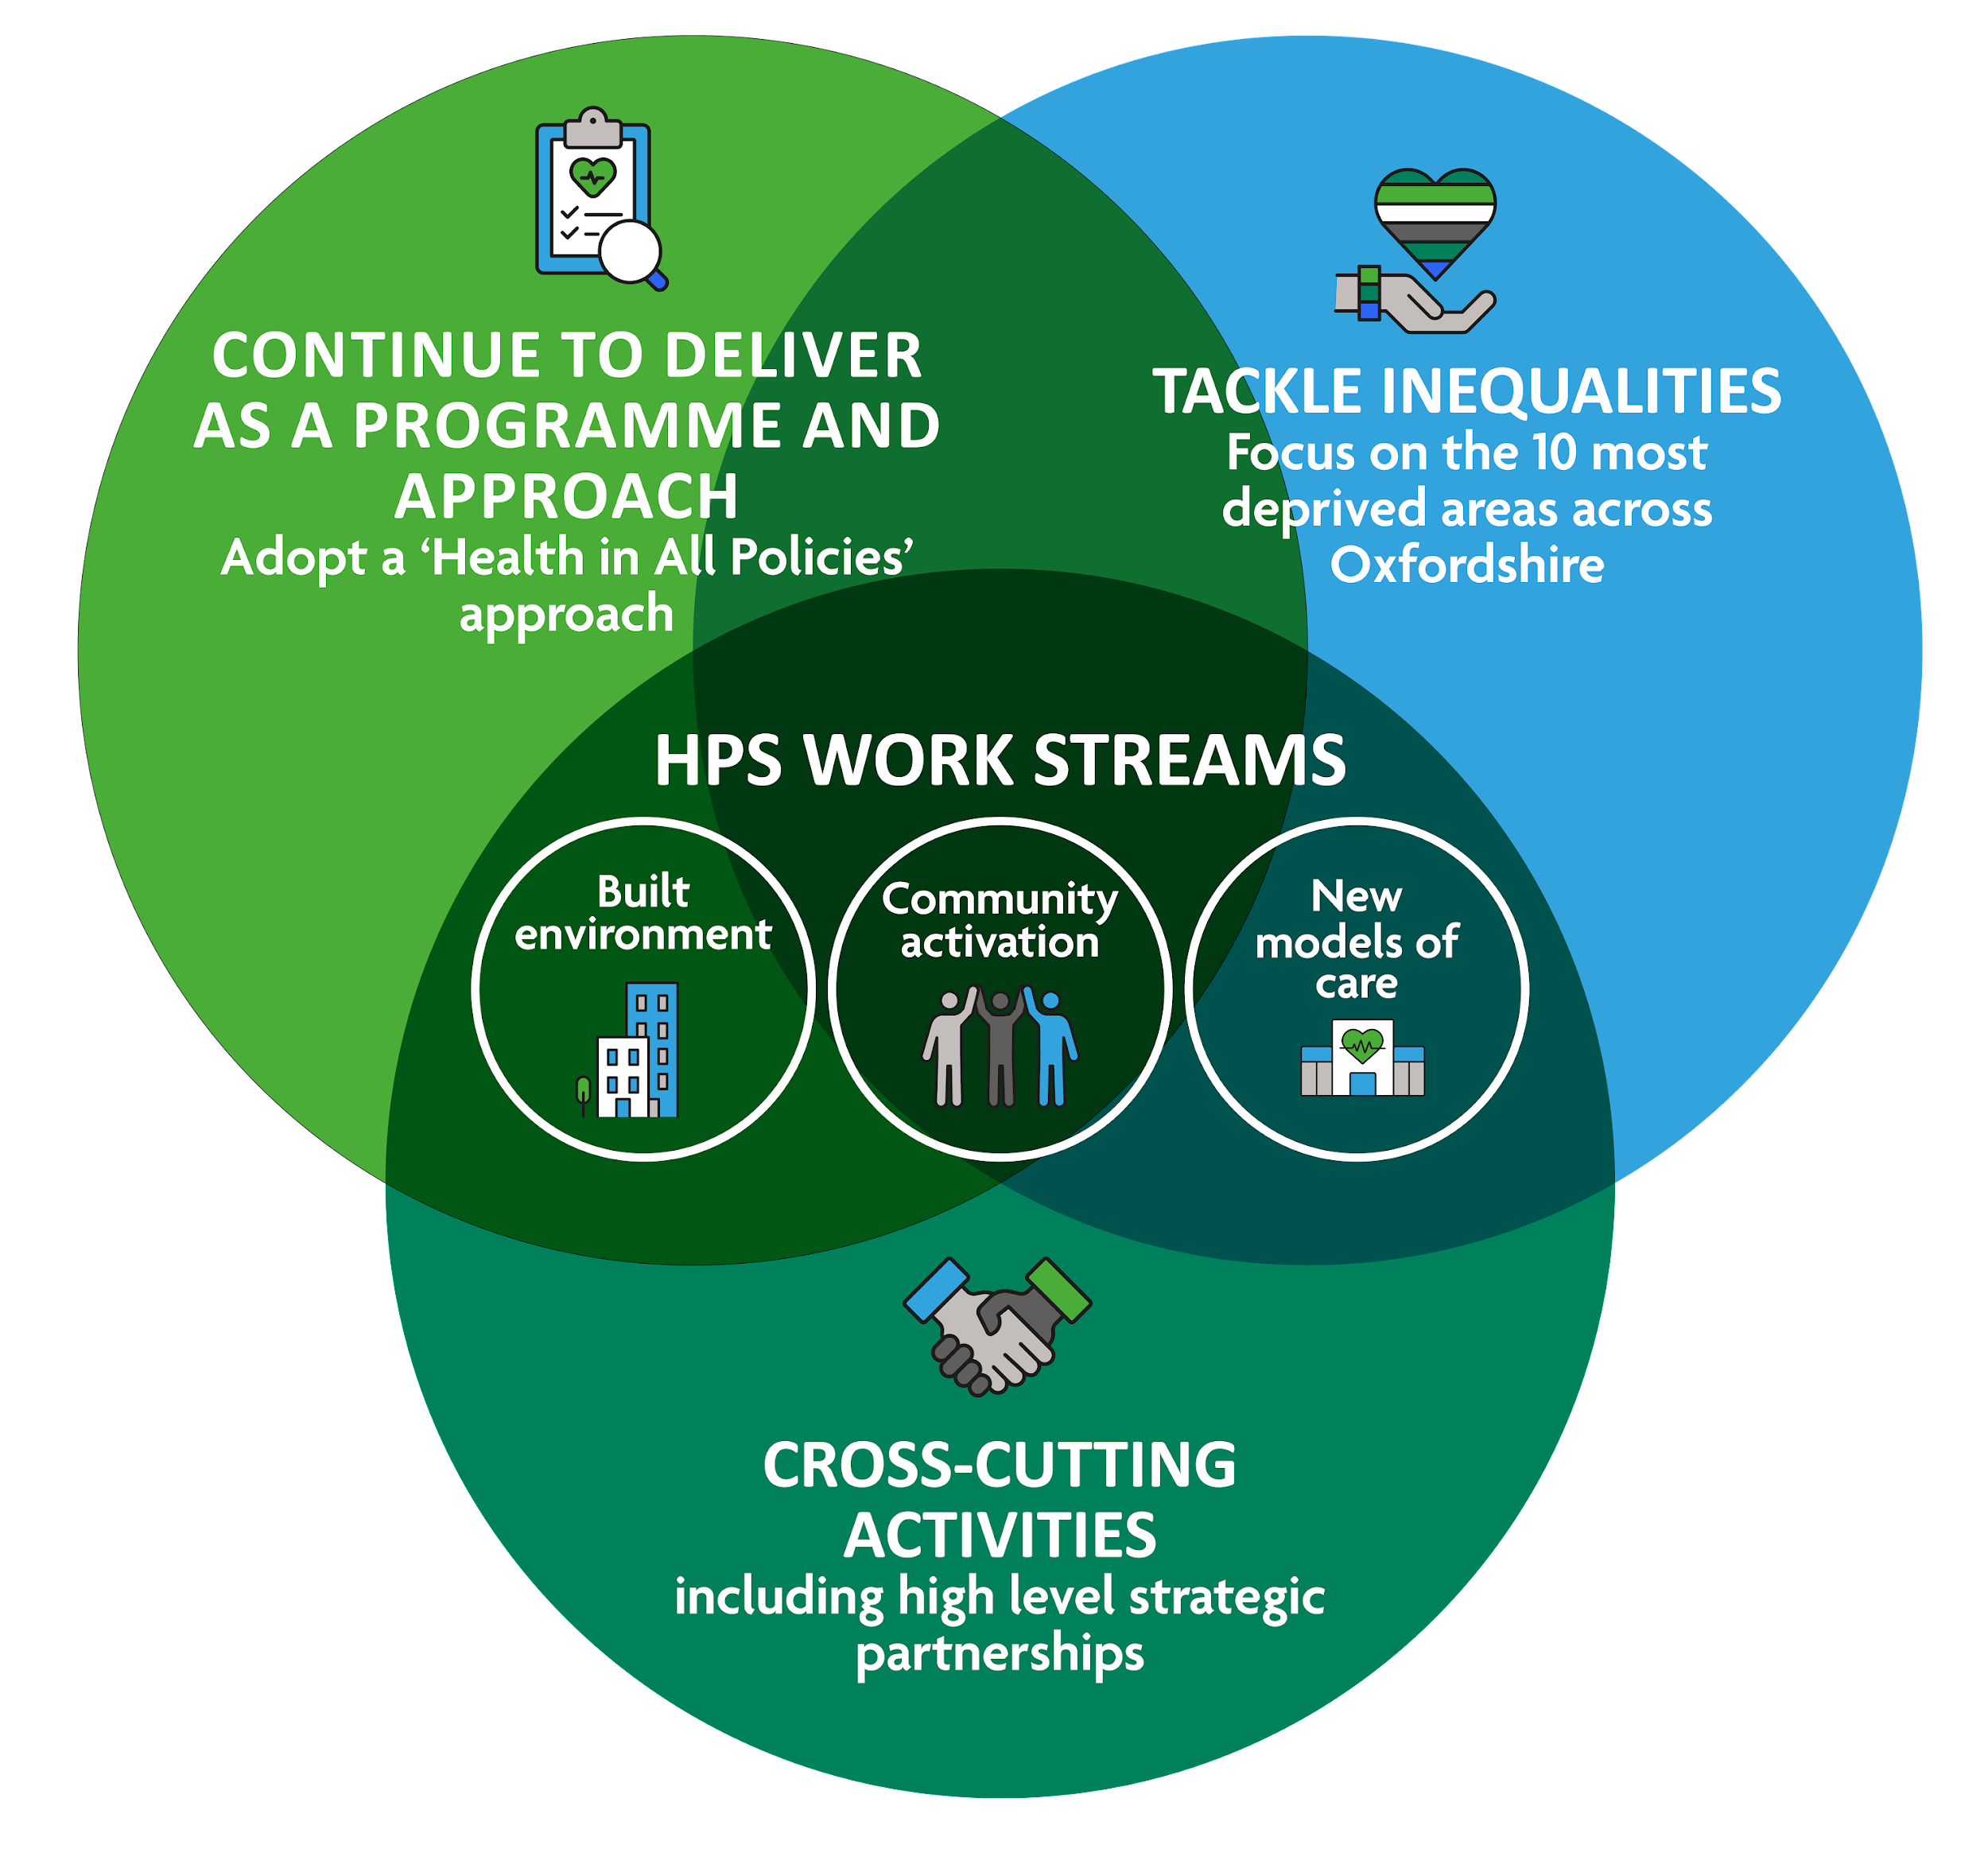
High level findings 1
Maintain the focus on the ‘top 10’ deprived electoral wards which are in Oxford (6), Cherwell (3) and Vale of Oxford (1). West and South Oxfordshire have none
HPS should continue to be supported to develop its full potential as both a programme and an approach
It is important to recognise that HPS involves a lengthy process of embedding and disseminating over many years.
HPS should extend its collaboration with the NHS using the opportunities that arise from primary care and PCNs and from both the ICS and Anchor Institutions.
HPS should address the wider cost-effectiveness of HPS as a programme and an approach in future evaluations.

Slide 30
High level findings 2
•There is strong evidence of the need to adopt a whole systems approach
•A whole systems approach is best supported by a ‘Health in all Policies approach’. This means the continued development and implementation of relevant plans and strategies that shape the urban environment and local economy.
•Large scale change is most likely if a range of initiatives are developed for an area rather than implementing single initiatives.
•Social media is a low-cost way of potentially supporting local people with exercise, their mental health and diet.
•Small grants to local community and voluntary organisations such as promoting physical activity and long term conditions care fosters co-design and community engagement.

Slide 31
Systems Evaluation and
Health Needs Assessment
Summary and Conclusions

Slide 32
Evaluation of HPS in Oxfordshire: - what is driving change?
Effective Systems Working and Place Based Programmes, based on:
Relationships: Post Covid systems working is stronger across Oxfordshire and supports Healthy Place Shaping
Behaviour: Healthy Place Shaping Behaviours and way of working
Common Purpose: There is a community of stakeholders with a shared understanding as to how HPS can promote healthy communities and a desire to work together to deliver change
Strategy: Healthy Place Shaping Principles are being embedded in Policy and Strategy across Oxfordshire
Interventions: The review confirmed that there is good evidence to support the programme of interventions taking place in Oxfordshire. But more evidence is needed to identify which activities might have the most impact
Data: more consistent use of common metrics and evaluation tools; recognising the importance of stories and statistics
Sharing Learning: across local authority, VCSE and health and social care
Resources: HPS as an approach is not resource intensive but funding is required to demonstrate tangible improvements for local communities

Slide 33
Key Findings - in 3 workstreams:
Built environment - good progress - HPS principles included in Local Transport & Connectivity Plan and Active Travel Strategy and Health & Wellbeing Board Strategy and in local plans and HIA in planning processes . Aligns to climate action to maximise co-benefits
Community activation - Moderate progress -Place based programmes increased and use HPS approach to engage a wide range of stakeholders to act on the health and wellbeing priorities of their community especially with high health inequalities
New models of Care - limited progress with NHS. Engagement with Social care including asset based approach and co-production embedded.
New opportunities for NHS engagement through ICS, its place based approach and its approach to inequalities, VCSE, anchor institutions, NHS Green Plan and Primary Care Networks

Slide 34
Systems Evaluation recommendations
HPS is an effective programme and approach – specific initiatives to achieve health outcomes as well as how we work together to promote health and wellbeing, - it is appropriate to continue to invest public funds into HPS
HPS needs to continue both as a programme and as an approach
Continue to invest in building a community of stakeholders to support HPS across Oxfordshire and strengthening the existing network.
Move towards ‘distributed leadership’ across HPS – supported through training/professional development
Sustain HPS behaviours
Continue to encourage professionals and organisations to cross traditional boundaries in their work
Consider the need for training/professional development programmes on population approaches to public health, and effective communications
Further embed HPS ‘upstream’ into policies and strategies of all organisations across Oxfordshire in order to ensure sustainability of HPS with programmes focused on narrowing health inequalities
Develop an approach to better engage with health organisations to address the HPS new models of care work stream and inequalities
Sustain its focus on inequalities both within the development of the HPS programme itself and in further evaluation work

Slide 35
Conclusions from HNA
PHAST has identified where HPS should be prioritised, what can be learned from other places and from previous Oxfordshire HPS activities. It has also identified what local leaders and stakeholders think should be the priorities for the next phase of HPS.
PHAST recommends that HPS in Oxfordshire:
Should continue to be supported to develop its full potential as both a programme and an approach.
It is important to recognise that HPS involves a lengthy process of embedding and disseminating over many years.
Continues to address inequalities in the ten most deprived areas of Oxfordshire.
Continues with the three workstreams – built environment, community activation and new models of care.
Should extend its collaboration with the NHS using the opportunities that arise from primary care and PCNs and from both the ICS and Anchor Institutions.
Should address the wider cost-effectiveness of HPS as a programme and an approach in future evaluations.

Slide 36
Overall Conclusions
HPS is both a programme and an approach, recognising that system work requires joined up (instead of silo working) and embedding HPS ‘upstream’ into policies etc. The ToC and Systems Behaviours underpin this.
Whilst the approach is not resource intensive, the programme of activities are needed for people to recognise change in local areas
HPS is worth continuing investment and scaling up.
Local political and other changes, including in NHS and other organisations, can be used as opportunities to embed HPS strategically, including with an inequalities lens

Slide 37
Client Reflections
Range of expertise influenced commissioning and supported effectiveness of the evaluation
Consultant team offered peer challenge and support to an innovative work programme
Iterative ‘action research approach’ supported programme development
Flexibility in terms of delivery of outputs was important
Added value: evaluation findings informed health needs assessment
Evidence review of interventions + systems evaluation + needs assessment = robust evidence base for prioritisation of future activity as well as case for investment

Slide 38
Lessons learned for PHAST and for OCC / HPS
Engaging appropriate expertise (eg systems science)
Remote working can be effective and efficient
Being flexible and adapting plans as necessary/regularly
Close working with client throughout, with regular updates
Utilising new methods and flexing existing methods as necessary
Bringing in wide PH knowledge across new topics
Adopting action research approach, with frequent feedback and embedding results into next stage
Having fun!

Slide 39
Questions?
Please put any questions into ‘chat’

